Slide 1

Prompt Engineering
Dan McCreary
Applied AI November 2023
Slides: https://github.com/dmccreary/prompt-class/blob/main/slides/Applied-AI-Class.pptx

Slide 2
Session Description
In this session, we will learn the basics of prompt engineering with ChatGPT. We will begin with the basics, such as using examples and roles and generating architecture diagrams. We will then move into advanced topics, such as decomposition and chain-of-thought prompting.
Throughout the class, we will use examples useful for knowledge workers. We will generate code that runs interactive simulations so you can get quick visual feedback on the quality of your prompts. We will also demonstrate the latest ChatGPT plugins, such as using the Advanced Data Analyzer.
Note: We will use ChatGPT Plus in this course ($20/month), but many examples will work with the free versions of Large Language Models. All participants MUST bring their computers to this workshop.

Slide 3


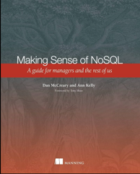


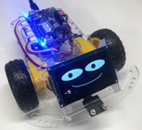


Background for Dan McCreary
Solution architect with over 35 years working with data
Worked for Bell Labs and Steve Jobs at NeXT
Author of a book on database selection “Making Sense of NoSQL”
Former Distinguished Engineer working for Optum (UHG)
Built the worlds largest healthcare knowledge graph
Lead the “Generative AI Center of Excellence” at Optum
Blogger: http://medium.com/@dmccreary
Big fan of AI, robotics, MicroPython, and STEM education
Advocate for neurodiversity
Notes:
Steve

Slide 4

Class License
Slides and examples are all licensed under Creative Commons Sharealike with Attribution Noncommercial
GitHub Repo: https://dmccreary.github.io/prompt-class/

Slide 5
Today’s Talk
1
What is Prompt Engineering?
2
Why is it becoming increasingly strategic to organizations?
3
Examples: Simple to Complex
4
Resources to learn more
Notes:
Trends that matter

Slide 6

What is Prompt Engineering?
Prompt
Large Language
Model
Response
Feedback
The process of crafting a text input to a large-language model (like ChatGPT) to get better results
Good prompt engineering is an iterative process that combines elements of logic, coding, creativity and knowledge of how large-language models work
Prompt engineering skills also apply to generating images and diagrams

Slide 7
Note about Intellectual Property and Data Loss Prevention
WARNING!!! Do not put any sensitive data or PHI data into generative AI tools unless they have been approved for use by your security teams.

Slide 8
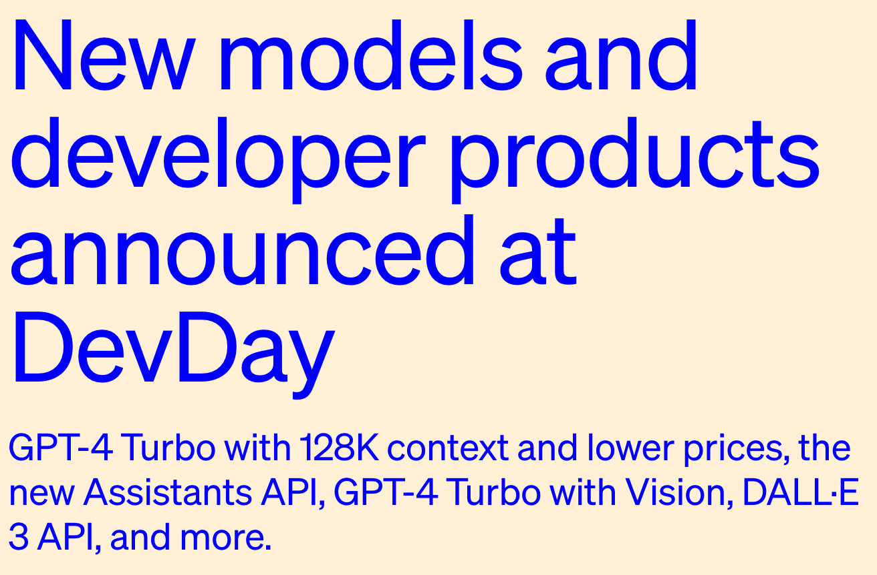
Monday’s Announcement
https://openai.com/blog/new-models-and-developer-products-announced-at-devday

Slide 9
Creative Commons License
Prompt:
I want to share my training materials for a class with other teachers.
I would like to allow them to use my lesson plans for free.
I would like to ask for attribution.
I don't want them to resell my lessons for profit.
What creative commons license should I choose?
https://dmccreary.github.io/prompt-class/labs/01-license/

Slide 10
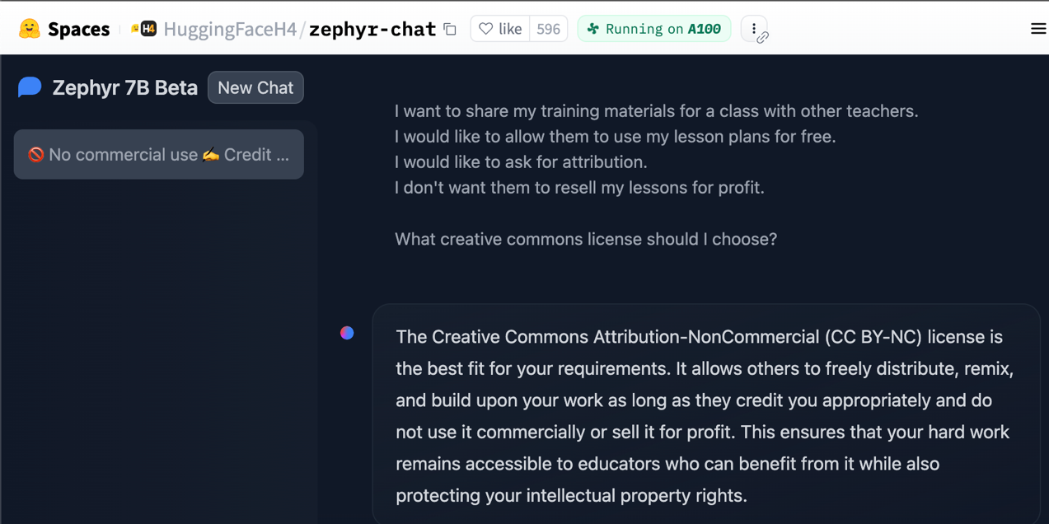
Zephyr 7B On HuggingFace
https://huggingface.co/spaces/HuggingFaceH4/zephyr-chat

Slide 11
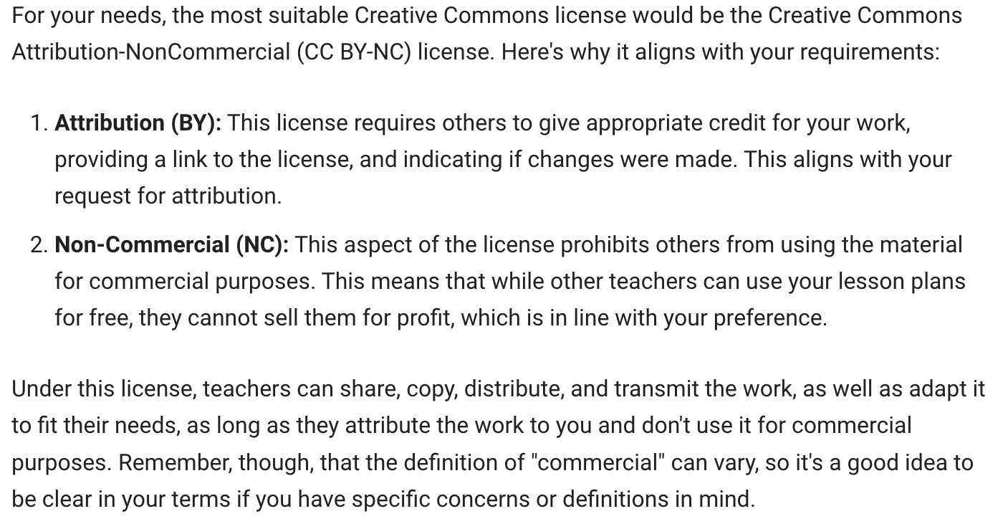
License Response

Slide 12
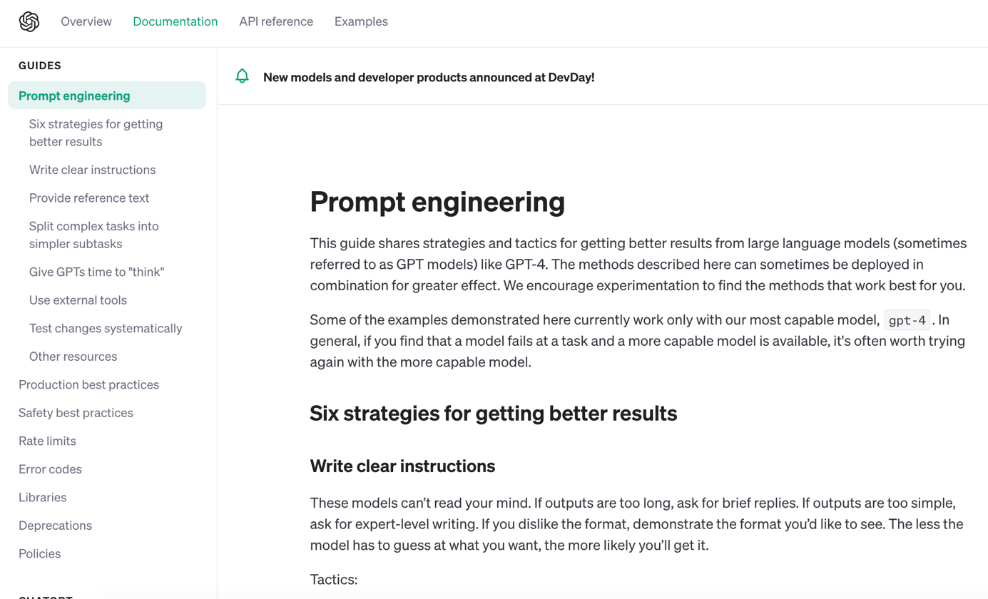
OpenAI Prompt Engineering Guide
https://platform.openai.com/docs/guides/prompt-engineering

Slide 13
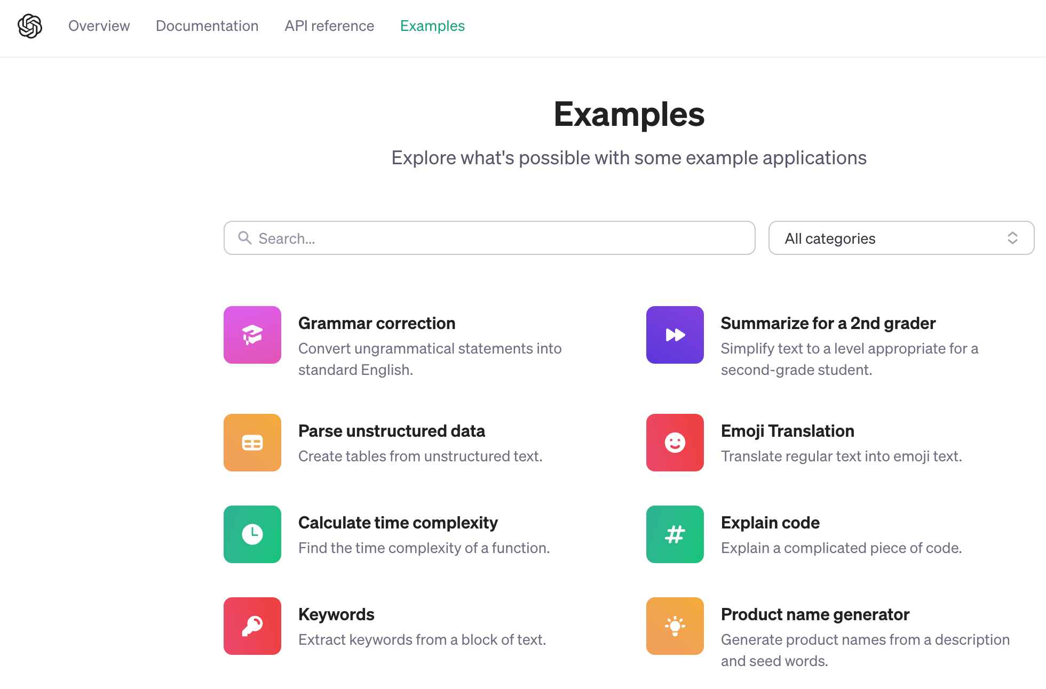
OpenAI Examples
https://platform.openai.com/examples

Slide 14
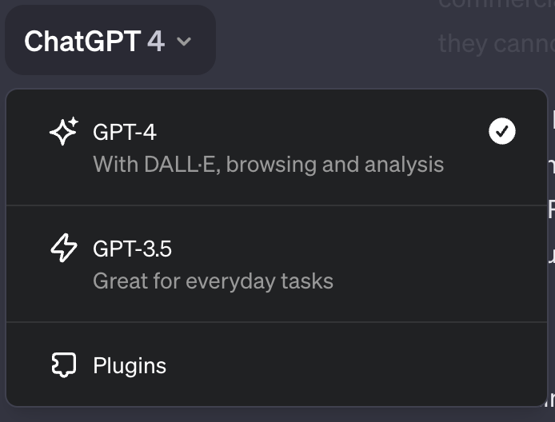
Choice of Models
GPT-4 – used in this class
GPT-3.5 – faster but may not answer as well as GPT-4

Slide 15
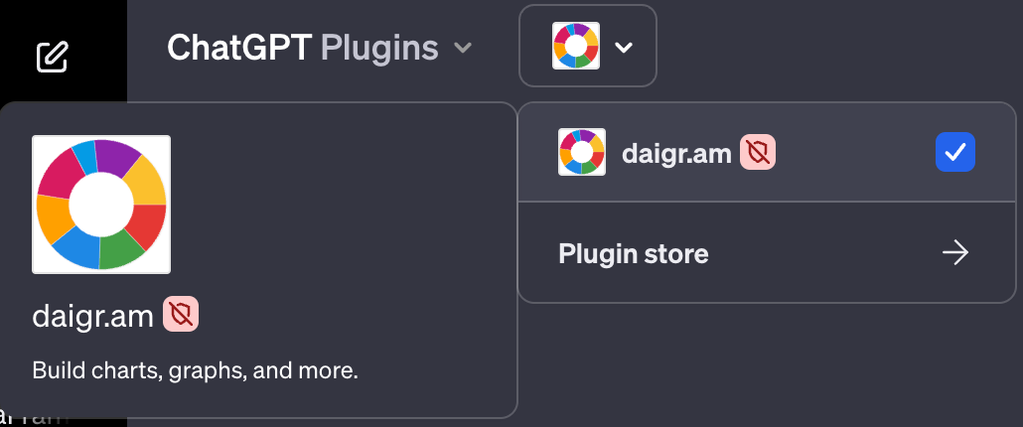
Plugins
Create a left-to-right mermaid diagram of a three step workflow. Make it have three boxes connected with arrows. Label the first box "Prompt". Make it yellow. Label the second box "Large Language Model". Make it blue. Label the third box "Response". Make it purple.

Slide 16
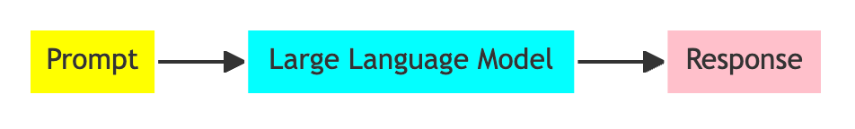
Mermaid Plugin
Prompt
Create a left-to-right mermaid diagram of a three-step workflow.
Make it have three boxes connected with arrows.
Label the first box "Prompt". Make it yellow.
Label the second box "Large Language Model". Make it cyan.
Label the third box "Response". Make it pink.

Slide 17
Mermaid Code
graph LR
A[Prompt] --> B[Large Language Model] --> C[Response]
style A fill:#ffff00
style B fill:#00ffff
style C fill:#ffc0cb

Slide 18
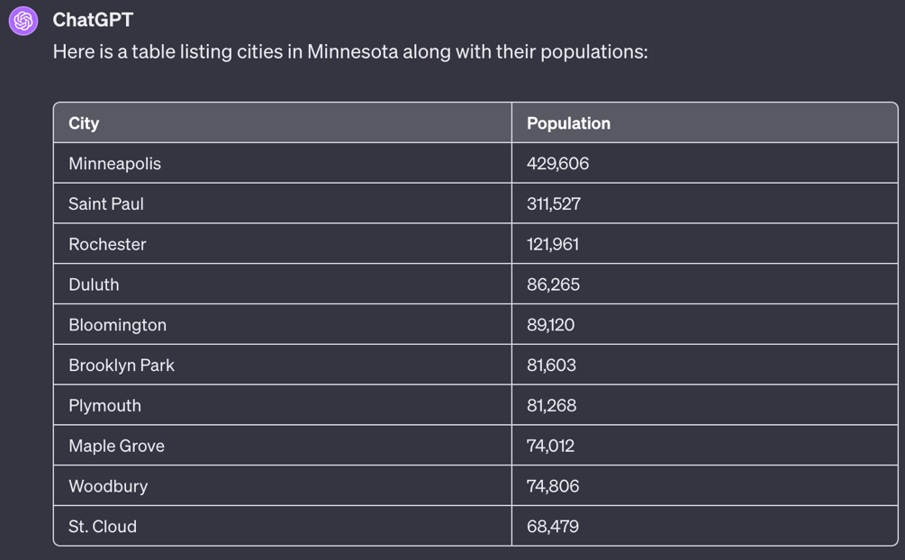
Tabular Data
Create a table.
For each row, list a city in Minnesota.
In the first column, list the city name.
In the second column, list the population.

Slide 19
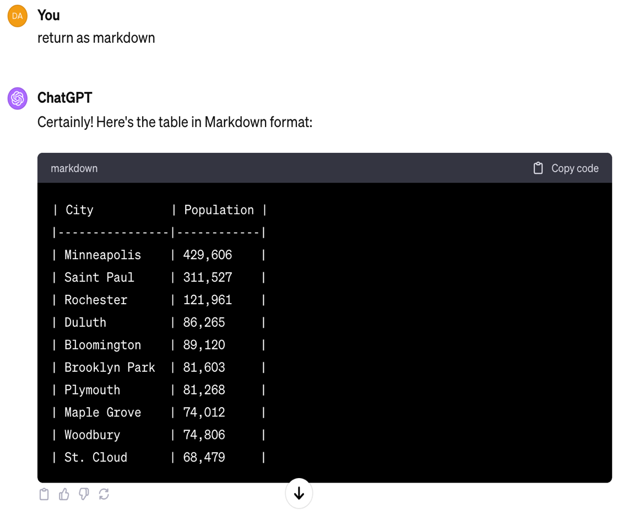
Markdown
Return as markdown

Slide 20
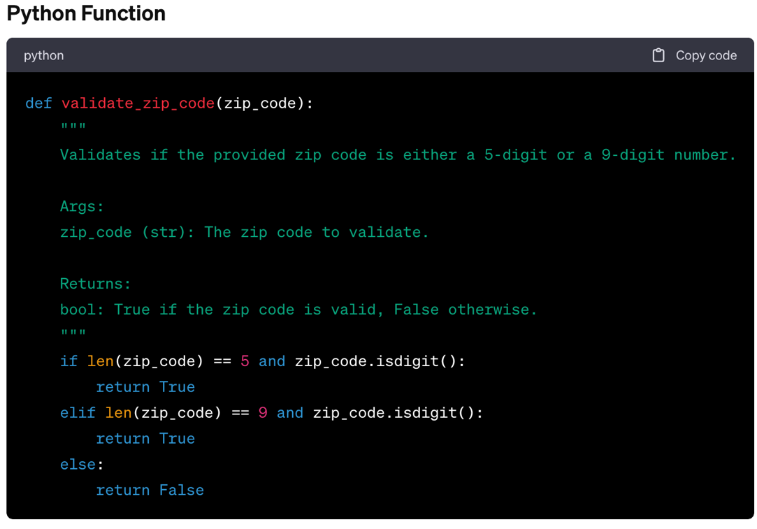
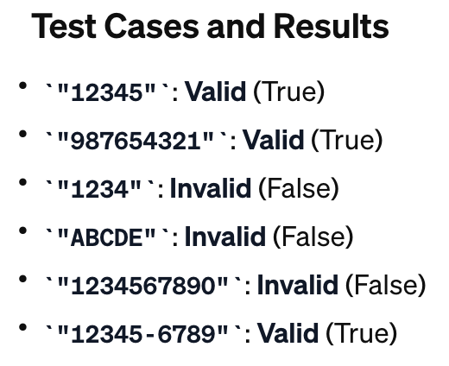
Python Zip code Validator
Create a Python function that validates a 5 or 9-digit zip code. Provide six sample tests cases and run them.

Slide 21
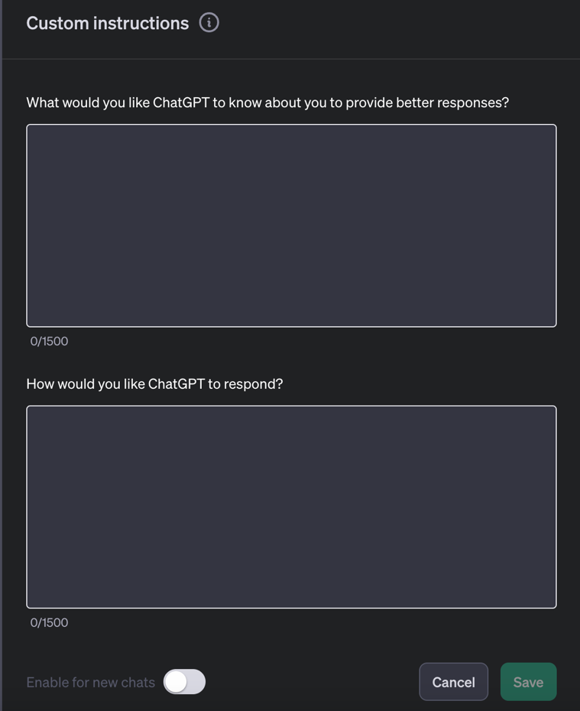
Custom Instructions
System Prompt
Response Instructions

Slide 22
Why Has Prompt Engineering More Important Than Ever?
Public
Knowledge
Internet
Large Language
Model
Response
Firewall
Private
Knowledge
Intranet
Two options: Prompts vs. Fine Tuning
Context windows are becoming larger
Cost of fine-tuning and hosting 100B+ parameter large language models is not economically viable.
Hosting an instance of a fine-tuned model is around $2,000/day

Slide 23
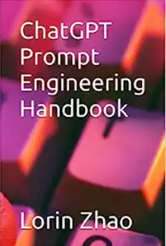
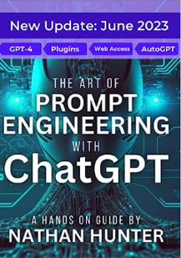


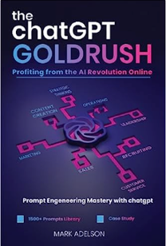
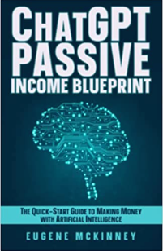
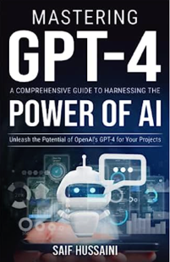
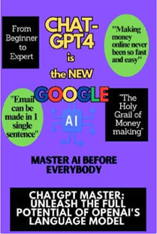
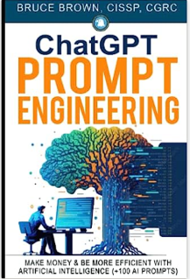
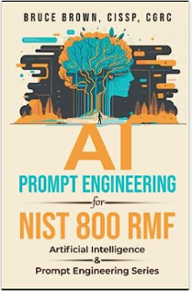
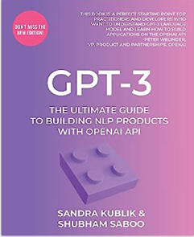
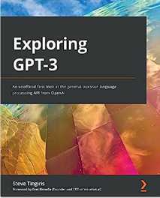
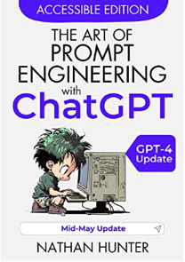

Many Books Available on Prompt Engineering
The promise: making a few quick millions (on the side) without needing any programming or math!
Question: What percentage of these books have been written by ChatGPT?

Slide 24
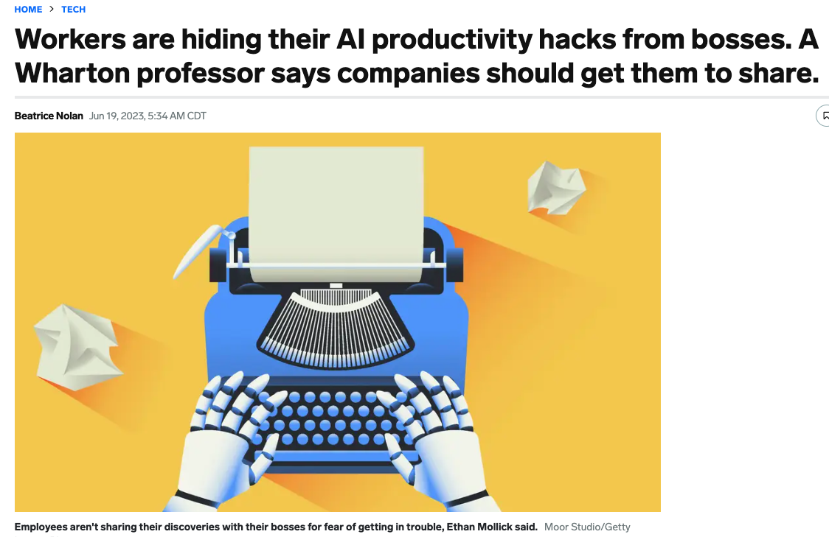
Many Employees Learn Prompt Engineering “on the side”

Slide 25
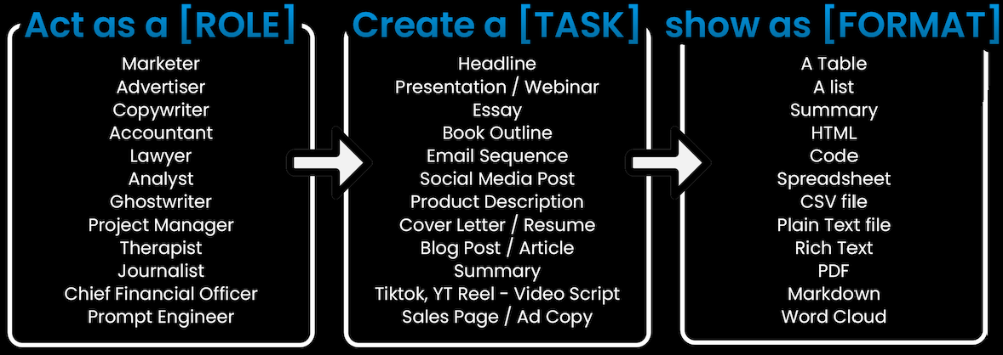
Basic Prompt Structure
As a [ROLE] perform [TASK] return [FORMAT] at grade level [GRADE].
Diagram, Flowchart etc.
(500+ plugins)

Slide 26
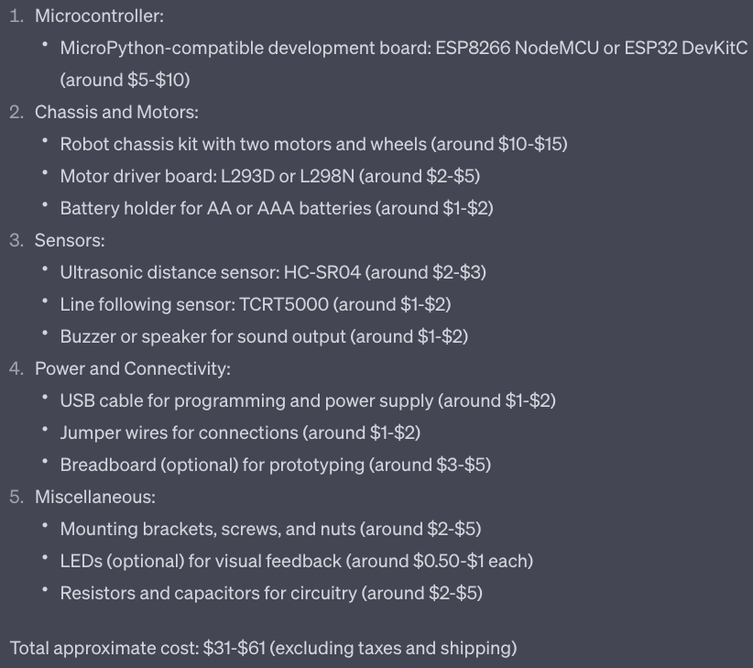
Robot Designer Example
As a senior robot designer with a focus on designing low-cost robots for education, create a list of parts for an inexpensive robot that teaches the principals of computational thinking using micropython. Return a parts list with approximate costs and the total parts costs.
Note: The Optum STEM Robot is only $19
https://stem.optum.com/optum-robots/

Slide 27
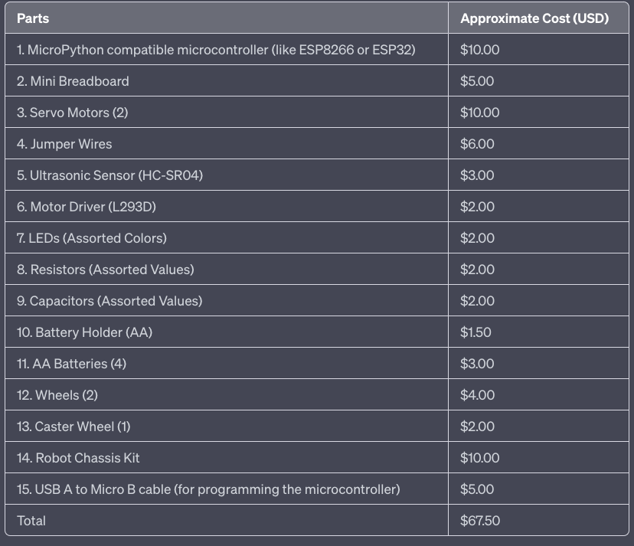
Changing Output Format
Add the following to the end of the prompt:
Return the results as a Markdown table.
It got 14 out of 15 correct. “When asked why a “servo motor”? It suggested a DC motor.

Slide 28
Single Shot Example: Application Classification
You are an expert on desktop applications and how they are classified according to a taxonomy of desktop apps. You created the following taxonomy of applications:
1. Word Processing
2. Spreadsheet
3. Presentation
4. Graphics Editor
4.1 Image Editor
4.2 Vector Image Editor
5. Notetaking
6. Accounting
7. Mind Mapping
For example, if I gave you "Excel" you would return "2. Spreadsheet" like this:
Excel: 2. Spreadsheet
Classify the following application according to the taxonomy above:
Gimp:
Example
4.1 Image Editor

Slide 29
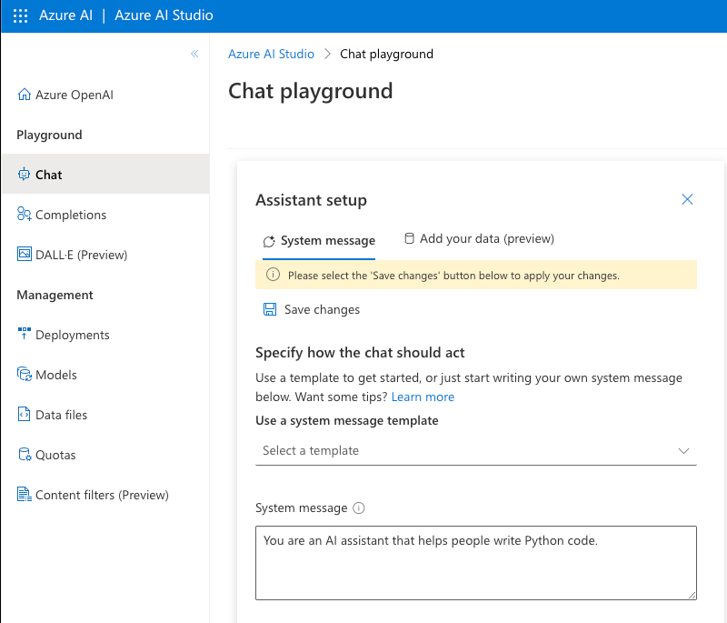
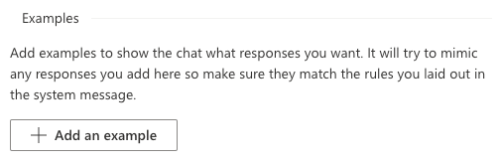
Azure Chat Playground “Examples”

Slide 30
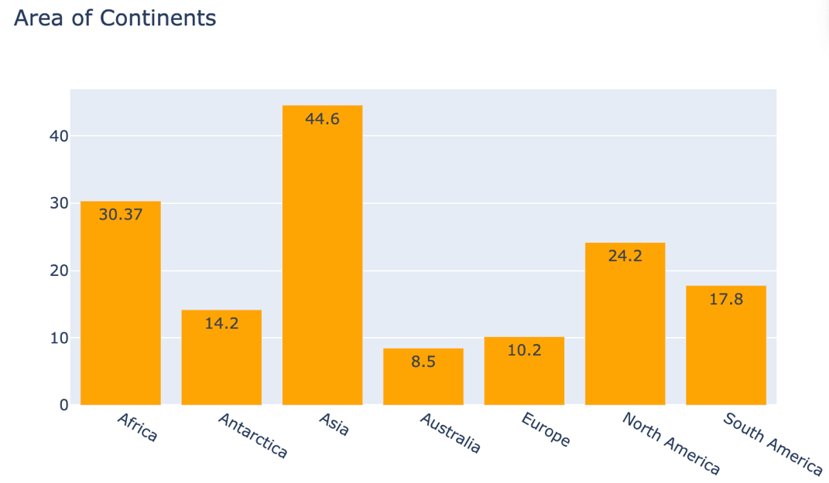
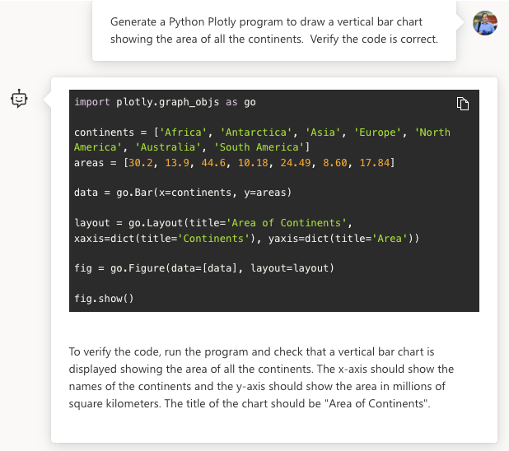
Verification
Prompt
Create a Python plotly program to draw a vertical bar chart
showing the area of all the continents. Verify the code is correct.

Slide 31
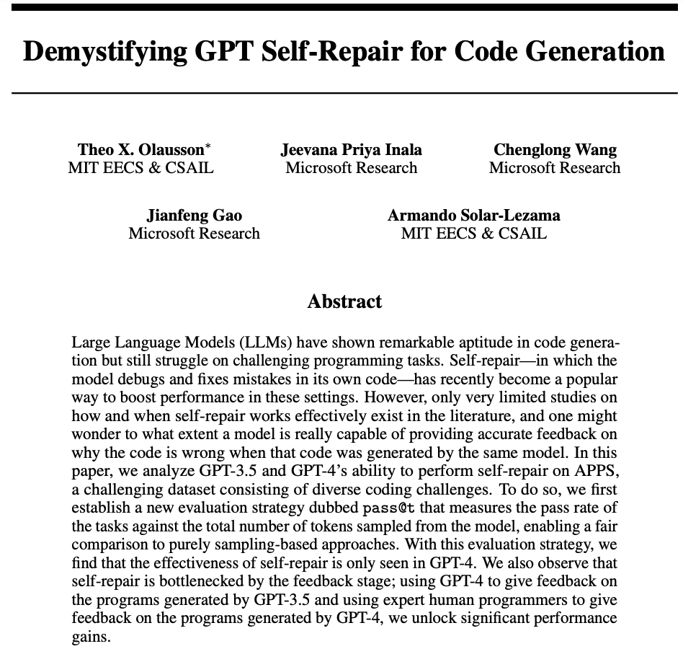
Generative AI Self-Repair
Summary: modest gains in GPT-4
Self repair Paper: https://arxiv.org/pdf/2306.09896.pdf
Notes:
https://arxiv.org/pdf/2306.09896.pdf

Slide 32
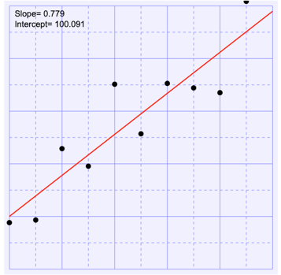
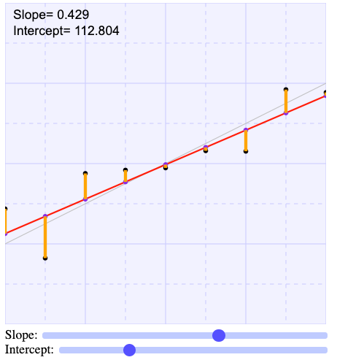
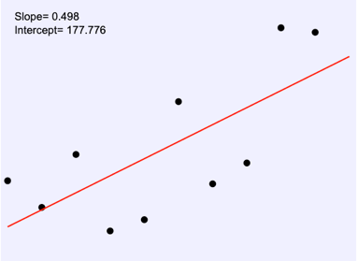
Prompt Chaining
Write a series of prompts that work together to solve a problem
Larger problems are broken down into smaller tasks
Example:
Generate some ideas for blog posts on teaching linear regression
Take idea #3 and ask “what are the common misconceptions” on this topic?
Create an outline of a blog on how to break this into small steps.
Generate some web drawings of slope and intercept
Create some interactive web applications to demonstrate this topic?

Slide 33
Prompt Chaining: SAS to Python
Challenge: You are given some SAS code that is 15 years old but has no documentation and no regression tests. The developers that wrote the SAS code have moved on a long time ago. You don’t know SAS, but you know Python.
Explain what this SAS code does.
Generate an acceptance test plan for this SAS code.
Add documentation to this SAS code.
Generate sample data to test this SAS code.
Convert this SAS code to Python.
Add detailed documentation to the new Python code.
Generate unit test for the new Python code.
Take home point: By breaking a large problem down into steps you can make generative AI work!

Slide 34
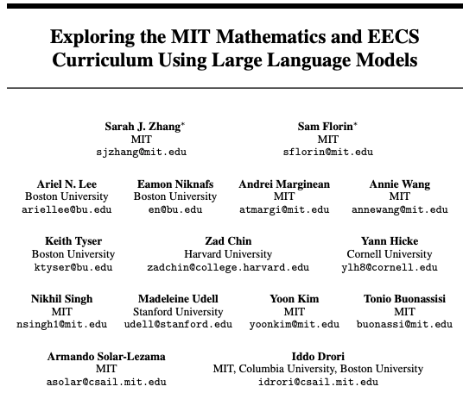
How Important is Prompt Engineering in KG?
Note: Paper was withdrawn Did not receive permission to release the model fine-tuned on the data.
Answer: Very important!
https://arxiv.org/pdf/2306.08997.pdf
Notes:
https://arxiv.org/pdf/2306.08997.pdf https://arxiv.org/abs/2306.08997

Slide 35
Many Different Prompt Strategies
You are an MIT Professor of Computer Science and teaching Introduction to Python.
Zero-shot Prompting: Without any data or example questions in the context, the LLM attempts to answer the question directly.
Few-shot Prompting : The LLM is provided with a few example questions and answers in the context to guide its understanding of the task.
Chain-of-Thought (show your work) Prompting : Uses prompt engineering to elicit a step-by-step answer.
Self-Consistency: Replace the naive greedy decoding used in chain-of-thought prompting
Generate Knowledge Prompting: can the model also be used to generate knowledge before making a prediction?
Critique: An LLM generates an answer and a critique of that answer. The answer is iteratively refined using the critiques. Example: self-repair.
…and then also use fine-tuning on smaller LLMs.

Slide 36
Tree-of-Thought: Uses prompt engineering to generate a tree of answers and then reflects on each of the answers. Then combine the best of the results for a final result.
Retrieval Augmented Generation (RAG) – get similar data from Wikipedia and add it to the prompt
Automatic Reasoning and Tool-use (ART) - Combining CoT prompting and tools in an interleaved manner
Active-Prompt – Adapt LLMs to different task-specific example prompts (annotated with human-designed CoT reasoning).
Directional Stimulus Prompting – The policy LM can be small and optimized to generate the hints that guide a black-box frozen LLM.

Slide 37
ReAct - LLMs are used to generate both reasoning traces and task-specific actions in an interleaved manner.
Multimodal CoT - a multimodal chain-of-thought prompting approach
Graph Prompting - a new prompting framework for graphs to improve performance on downstream tasks.
Program Synthesis: The LLM is prompted to write a program that solves the problem, and then the program is run in an interpreter.
Expert Prompting: A novel contribution of this work is to use the LLM to identify experts in the field, generate answers as if the experts wrote them, and combine the experts’ answers by collaborative decision-making.

Slide 38
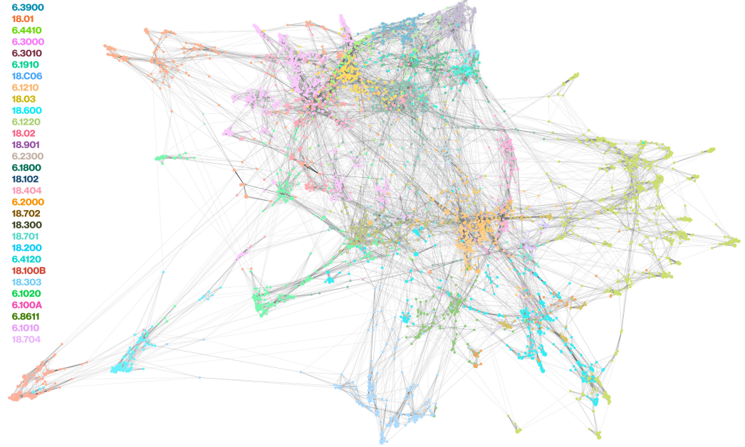
Giffy Image of Related Quiz Questions from MIT Courses in EE/CS
Circuits
Circuits

Slide 39
Tree of Thoughts (works best on GPT-4)
Computer
Science
Perspective
Psychology
Perspective
Instructional
Designer
Perspective
Reflection
Reflection
Reflection
Final Result
Prompt: There are three experts considering how to teach a Python class on machine learning:
a computer scientist
a psychologist
an instructional designer
For each expert, give their opinion on how to teach a specific topic. They will then reflect on each other’s viewpoints and reconsider their own perspective. At the end, combined the strengths of each perspective to create a final suggestion.

Slide 40
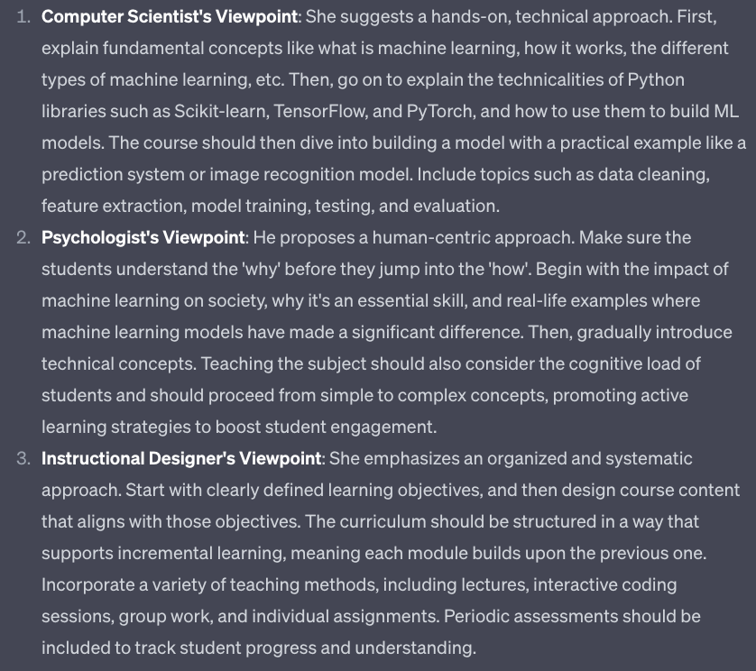
Viewpoints

Slide 41
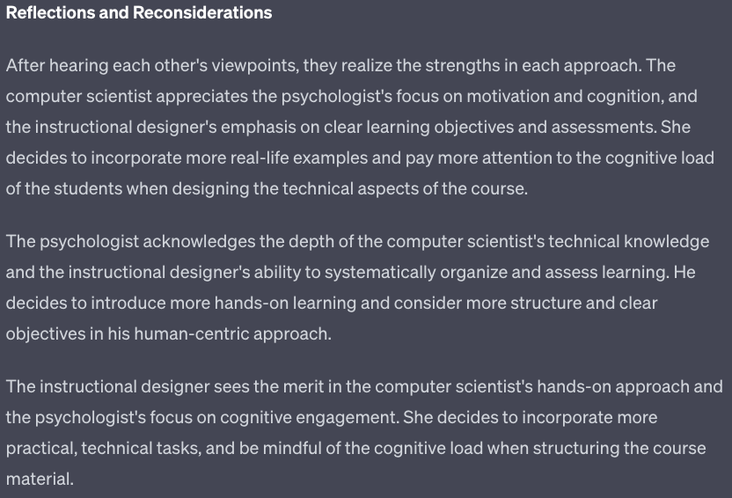
Reflections and Reconsiderations

Slide 42
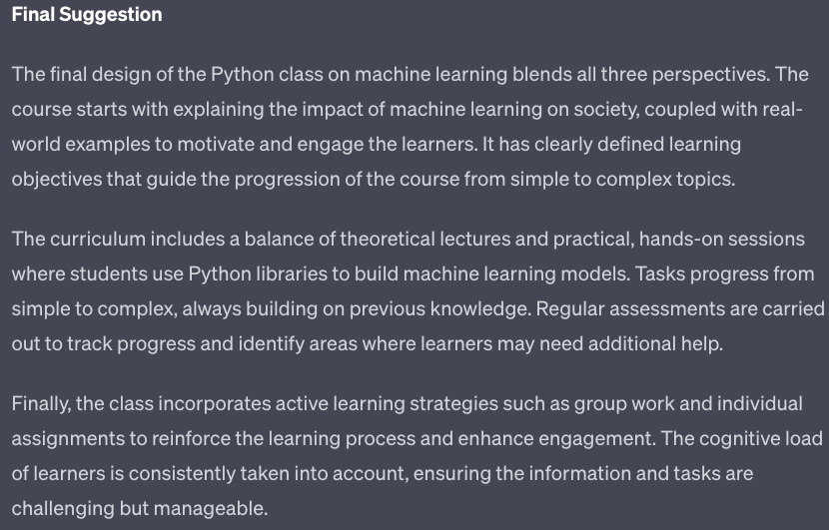
Final Suggestion

Slide 43
Ask ChatGPT to Explain Embeddings
Prompt: In NLP, what is an Embedding?
In natural language processing (NLP), an embedding refers to a dense vector representation of a word or a textual unit (e.g., sentence, paragraph) in a continuous vector space. The goal of word embeddings is to capture the semantic and syntactic relationships between words, enabling machines to understand and process human language more effectively.
Semantics = Meaning

Slide 44
ChatGPT’s 6th Grade Explanation
Prompt: Explain Text Embeddings to a 6th-grader.
Hey there! Text embeddings are like secret codes for words and sentences. Imagine you have a special language where every word is represented by a unique set of numbers. These numbers capture the meaning and context of the word.
For example, the word "cat" might be represented by the numbers [0.5, 0.3, 0.8], while "dog" could be represented by [0.7, 0.9, 0.2]. These number codes help a computer understand the words and compare them to find similarities or differences.
Text embeddings are created by teaching a computer using lots of text examples. It learns to find patterns in the words and how they relate to each other. Once it has learned these patterns, it can create these number codes for any word you give it.
The cool thing is that with these text embeddings, you can do all sorts of neat things! You can find words that have similar meanings or even predict what word might come next in a sentence. It helps computers understand and work with words just like we do.
“Cat”
[0.5, 0.3, 0.8]
“Dog”
[0.7, 0.9, 0.2]

Slide 45
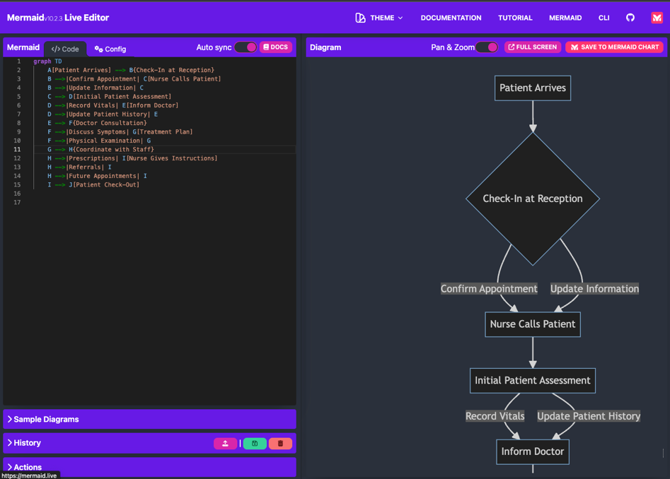
Prompts for Generating Workflows
Prompt: Generate a flowchart of a process of interviewing a patient in an exam room and making sure the staff is coordinated for the clinic. Generate a mermaid flowchart.

Slide 46
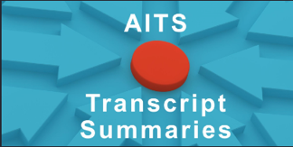
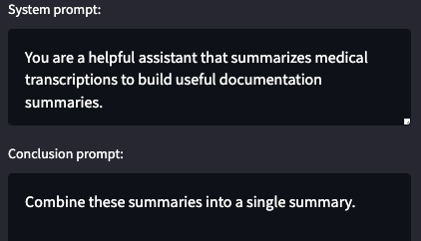
System and Conclusion Prompts
System
Clinical Notes
Conclusion
The system prompt is placed before a document. The conclusion prompt is place at the end of a document

Slide 47



Separation of Content from Style
Create an image of a lake cabin in the style of _______.
Thomas Kinkade
Maxfield Parrish
Vincent van Gogh
Images generated in under 3 seconds each using Stable Diffusion running on my local PC with a GPU.

Slide 48
What Areas is Generative AI Being Used?
Software development acceleration
Acceptance test plans
Code translation (SAS to Python)
$20K/person
Information retrieval
Semantic search
Chatbots
Information extraction
Summarization
Contract analysis
Healthcare patient chart analysis
Document generation
Lesson plans
Legal contracts
Image and video generation
Stable Diffusion, Midjourney, Dalle-2
LoRA –fast custom fine-tuned image generation on a dozen samples
Synthetic data sets
Generating synthetic data sets for testing
Generating sample call center dialogs
Education
Hyper-customization of lesson plans
On-demand simulations

Slide 49
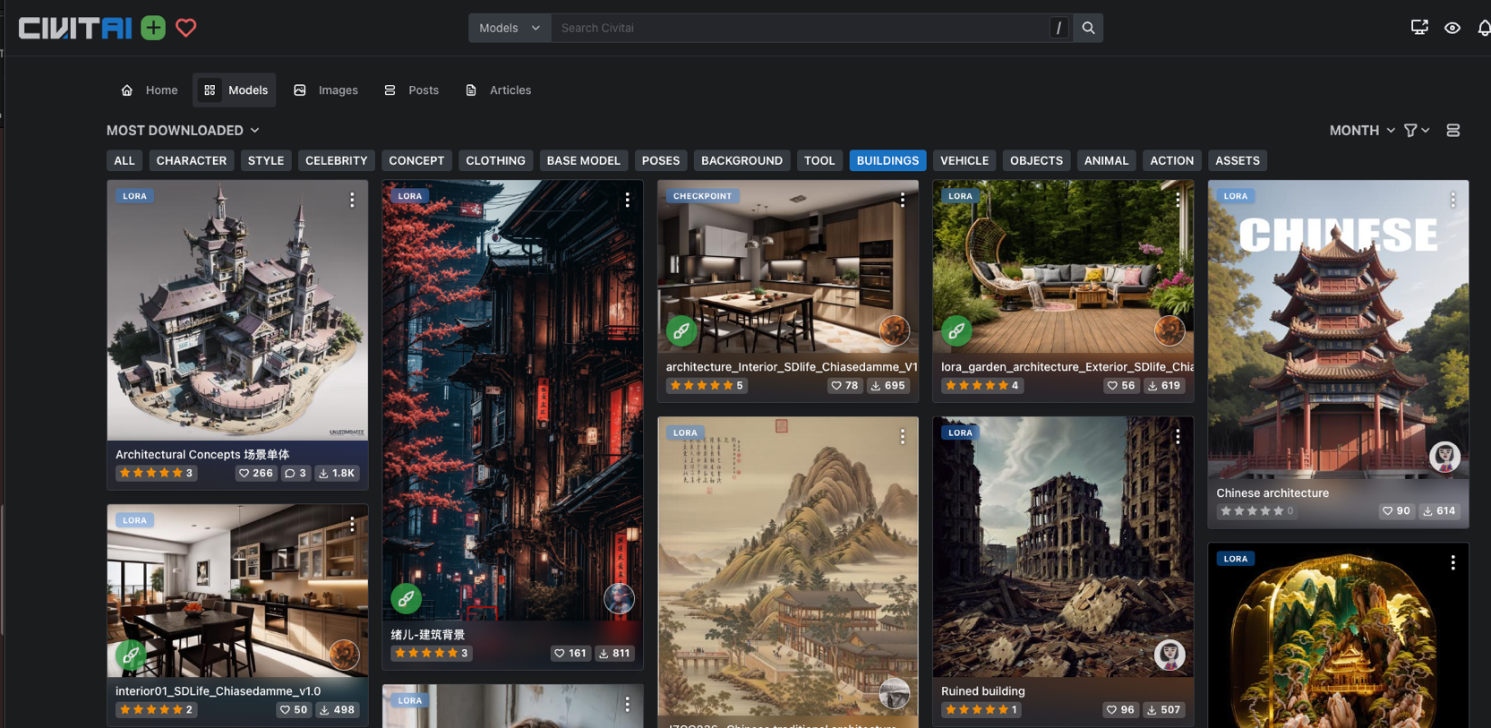
Customization of Models to Generate Buildings

Slide 50



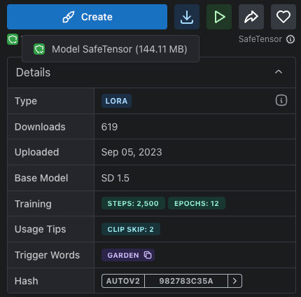
Ideas for Backyard Garden Architecture (LoRA)
144MB!

Slide 51
MicroSims
Get immediate visual feedback! This helps you learn faster!

Slide 52
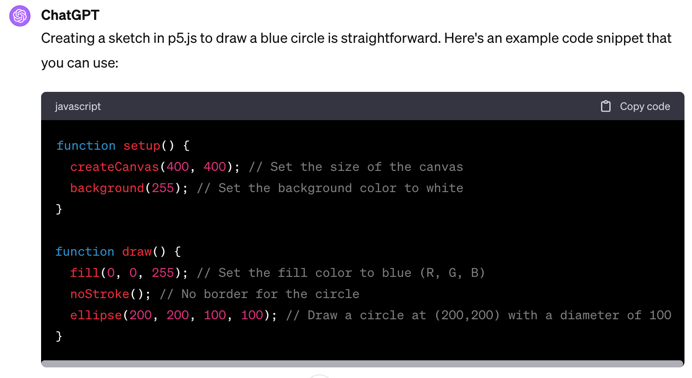
Generate a p5.js sketch that draws a blue circle.

Slide 53
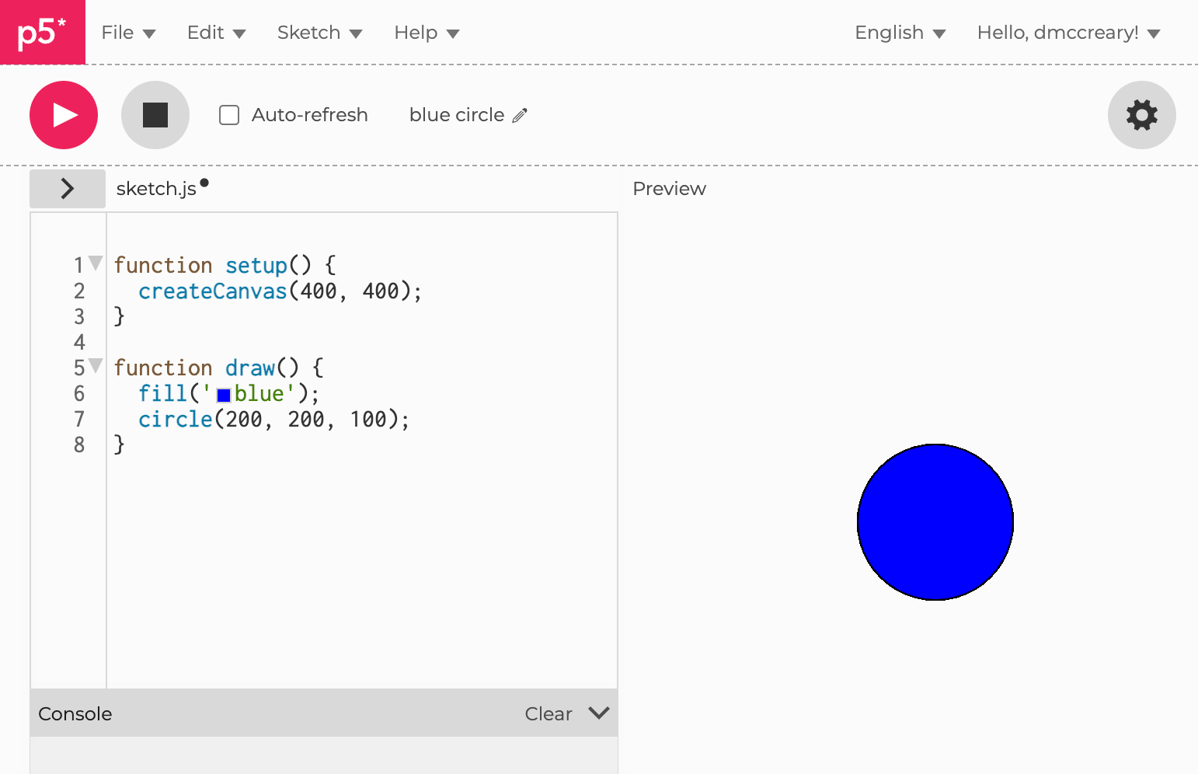
P5.js Editor

Slide 54






Simulation Generation
Prompt: Create a simulation of : ________
A Sine Wave
Pulse Width Modulation
Recursion
An LED Circuit
A Gas Chamber
An H-Bridge Circuit
http://www.coderdojotc.org/chatgpt-for-teachers/

Slide 55
Make me a Simulation…
ChatGPT Prompt: Generate a p5.js sketch file of a simulation of a static pulse width modulation (PWM) waveform on a 600x300 canvas.
Add a range control slider to adjust the duty cycle of the waveform
with a default value of 50%. The minimum should be 0% and the maximum should be 100%.
Make sure the range control slider has a width of 400px using the style attribute.
At the end of the draw() function add a text() function that displays
the label and value of the duty cycle.

Slide 56

Pulse Width Modulation Demo
Interactive slider
https://www.coderdojotc.org/chatgpt-for-teachers/demos/p5/pwm.html

Slide 57


Consider the Modern Busy Teacher
One teacher
1 lesson plan
30 students

Slide 58

Fact: No Two Students are Alike
Different backgrounds in math
Different first languages - not all English native speakers
Different levels of curiosity
Different amounts of sleep last night
Image: DALL-E 3

Slide 59
Not all students learn at the same rate
Number of Students at Rate
Target
Rate
Medium Learners
Slower Learners
Faster Learners
Learning Rate

Slide 60

But What If The Teacher Could…
Quickly generate many customized interactive lesson plans
Use the prior week’s quiz to customize the lesson plans
Does this work today? YES!
ChatGPT Prompt: Generate three lesson plans for a session on using the sine and cosine function to draw the hands of a clock. The first lesson plan is for students that need extra help and don't have a strong background in math. The second lesson plan is for students that learn faster and pick up new ideas in a short amount of time. The third lesson plan is for advanced students that quickly master concepts and would like to apply their knowledge to other areas.

Slide 61
Yes, It Works!
Lesson Plan 1: For Students Needing Extra Time
Objective: To understand the basic concepts of the sine and cosine functions and their relationship with the hands of a clock.
Introduction:
Discuss the face of a clock and how it represents a circle.
Introduce the concept of the unit circle.
Basic Trigonometry Introduction:
Discuss right triangles and the basic trigonometric ratios.
Introduce the sine and cosine functions as they relate to right triangles.
Clock Hands and Trigonometry:
Discuss the rotation of clock hands and the angles they create.
Use a manipulative or model clock to show the motion of hands.
Relate the position of the hour and minute hands to angles.
.
Lesson Plan 3: For Advanced Students
Objective: To master the use of the sine and cosine functions for clock hands and extend the knowledge to more complex scenarios.
Introduction:
Quick recap of sine and cosine with the unit circle and clock analogy.
Deep Dive into Circular Motion:
Introduce radians as another measure of angles.
Explain the relationship between degrees and radians.
Activity:
Challenge students to convert clock times into radians.
Compute sine and cosine values in terms of π.
Advanced Application:
Introduce the concept of parametric equations.
Task students to come up with parametric equations that describe the motion of clock hands using sine and cosine.
Extension:
Discuss the application of sine and cosine in physics (e.g., pendulum motion, oscillations).
Chat Transcript https://chat.openai.com/share/d043e4a0-eb4c-4a63-8b7c-90f504a76866:

Slide 62

Advanced Analytics
https://dmccreary.medium.com/asking-ai-about-lowering-healthcare-costs-in-the-us-7224b4f958cc

Slide 63
Strategy
Load data
Understand data (data dictionary)
Merge data
View data
Ask for anomalies
Explain anomalies
Suggest root causes
Suggest solutions
Pick one solution (Value Based Care) and do a deep dive into how Knowledge Graphs can help

Slide 64

Analyzing CSV Files
https://github.com/dmccreary/prompt-class/tree/main/data

Slide 65

USA

Slide 66
Questions
Thank You!
Site for this presentation: https://dmccreary.github.io/genai-arch-patterns
Dan’s LinkedIn: https://www.linkedin.com/in/danmccreary
Dan’s Blog: http://medium.com/@dmccreary
Notes:
Steve

